Slide 1
CSSE 332 User-space and Kernel Thread
Tuesday, December 4, 2018

Slide 2
Agenda
Review user thread and its limitation.
How kernel thread can help solve the problems?
How kernel thread works?
The implementation approaches of user/kernel threads.
Useful resource:
http://www.it.uu.se/education/course/homepage/os/vt18/module-4/implementing-threads/
http://pages.cs.wisc.edu/~remzi/OSTEP/cpu-mechanisms.pdf

Slide 3
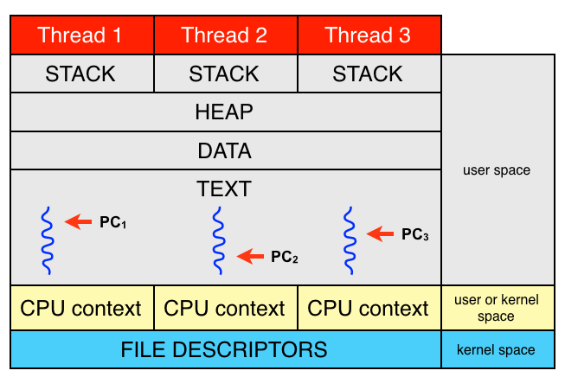
Thread overview
A subtask of a process
Comprises
A thread ID
A program counter
A register set
A stack
Shares with other threads of the same process
Code section
Data section
Other OS resources (open files, signals, etc)

Slide 4
User-space thread review
Lab1

Slide 5
User-space thread review (cont.)
Lab2

Slide 6
Limitations of user-space thread
They can't run simultaneously on multiple CPUs if my system has multiple CPUs
If one user space thread does something that causes a wait (e.g. requests something from memory, disk, the network) the OS will de-schedule all the user space threads
They have to manually yield – they can't be preempted

Slide 7
Have we solved our problems?
Multithreading
The OS knows about each thread, and can schedule them independently on different CPUs
Waiting
The OS knows about each thread, and can have one wait while others complete for the CPU
Preemption
Individuals threads can be preempted like individual processes

Slide 8
Kernel Thread
Kernel level threads are supported and managed directly by the operating system.
The kernel knows about and manages all kernel threads.
OS has to maintain the context of each kernel thread.
Provide system calls to create and manage kernel threads from user space.

Slide 9
System Call
Request a service from the OS kernel:
File manipulation
Open/Close
Read/Write
Stat
Process Control
Fork/Exec
Wait
Signal
Communication
Socket
Listen/Bind
Connect
/usr/include/sys/syscall.h

Slide 10
Traps
To request a service, a user application performs a trap to interrupt the CPU and force it to look up a handler function in the trap table.
User Mode
Kernel Mode
(1) Application makes a system call
(2) Control passes to handler
The trap table is loaded at boot by the kernel, which registers which functions to execute based on the system call number.
(3) Trap handler runs
(4) Handler returns to instruction following syscall

Slide 11
User-space thread to kernel thread
There are various models to map user-level threads to kernel-level threads. E.g.,
Many-to-One
One-to-One
Many-to-Many
A kernel thread is similar to a process in a non-threaded (single-threaded) system. The kernel thread is the unit of execution that is scheduled by the kernel to execute on the CPU. The term virtual processor is often used instead of kernel thread.

Slide 12
Many-to-One
User-space thread only
No parallel
Examples:
Your user-space thread library
Solaris Green Threads
GNU Portable Threads

Slide 13
One-to-One
Limited number of threads available
Examples:
Windows NT/XP/2000
Linux
Solaris 9 and later

Slide 14
Many-to-Many
Allows many user level threads to be mapped to many kernel threads
Allows the operating system to create a sufficient number of kernel threads
Examples:
Solaris prior to version 9
Windows NT/2000

Slide 15
Scheduler Activation (optional)

Slide 16
Disadvantages of kernel thread
Kernel manage and schedule all threads.
Significant overhead and increase in kernel complexity.
Thread operations are hundreds of times slower compared to user-level threads.

